Slide 1
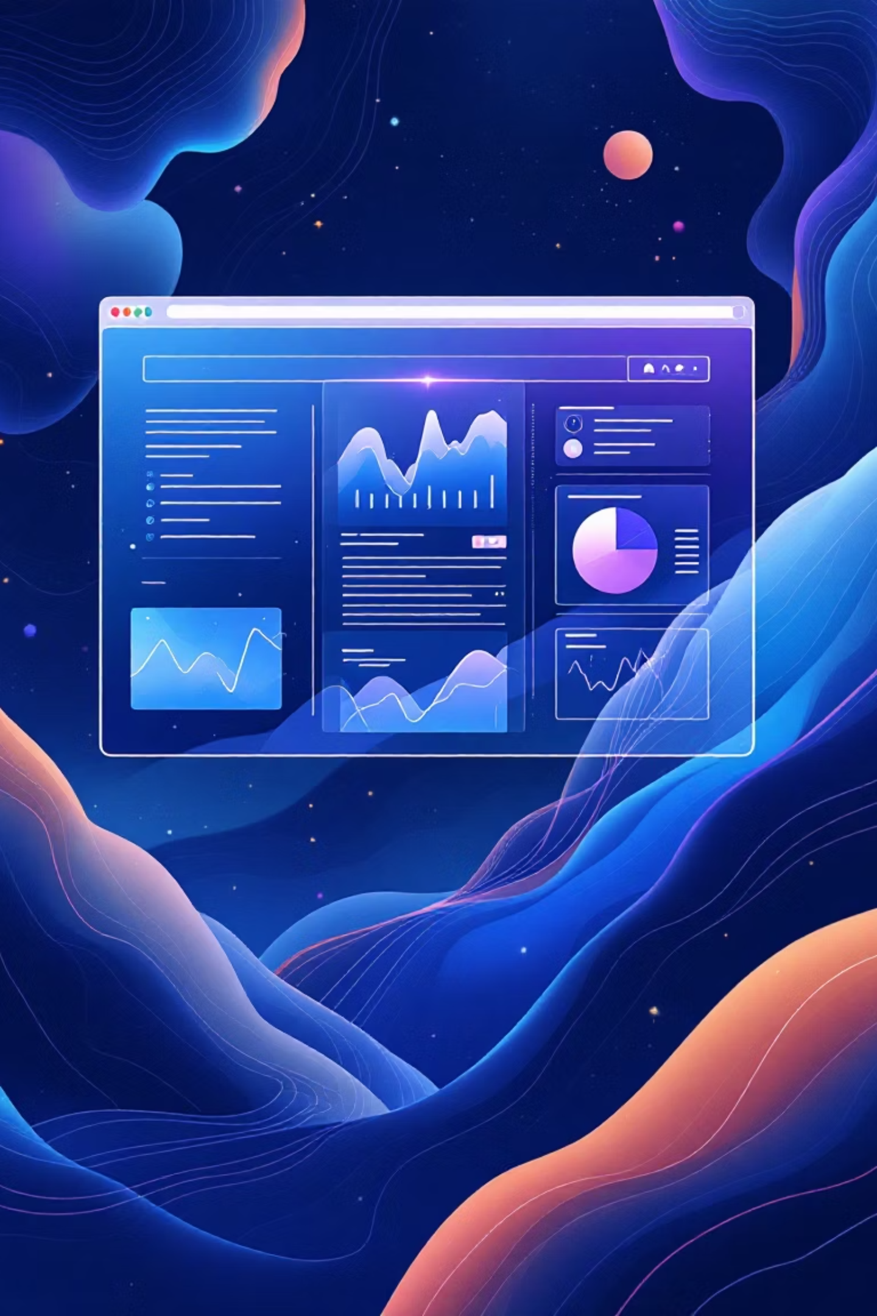
Web AI Navigator – Web Pilot
Revolutionizing web automation through intelligent AI-driven navigation

Slide 2

The Challenge We Face
Build an AI Agent that can take natural language instructions and autonomously drive the web on a local computer. The system should combine a locally running LLM (for understanding and planning) with a browser automation setup such as Chrome Headless or a browser inside a local VM.
Users should be able to give simple commands like "search for laptops under $50k and list top 5" and the agent should execute them by controlling the browser, extracting results, and returning structured outputs.

Slide 3

Introducing Web AI Navigator
Natural Language Interface
Autonomous Execution
Speak to the web in plain English — no coding required
AI handles complex multi-step browsing tasks independently
Local Privacy
Everything runs on your machine — your data stays secure
Web AI Navigator bridges the gap between human intent and web automation, making complex browsing tasks as simple as having a conversation.

Slide 4

The Core Concept
Natural Language Processing
Autonomous Browser Control
Transform everyday language into actionable web commands. Our AI understands context, intent, and nuance in user requests.
Execute complex browsing workflows without human intervention. Navigate, click, scroll, and extract data seamlessly.
Intent recognition and parsing
Dynamic element detection
Smart wait strategies
Multi-step task decomposition
Adaptive error handling
Context-aware decision making

Slide 5
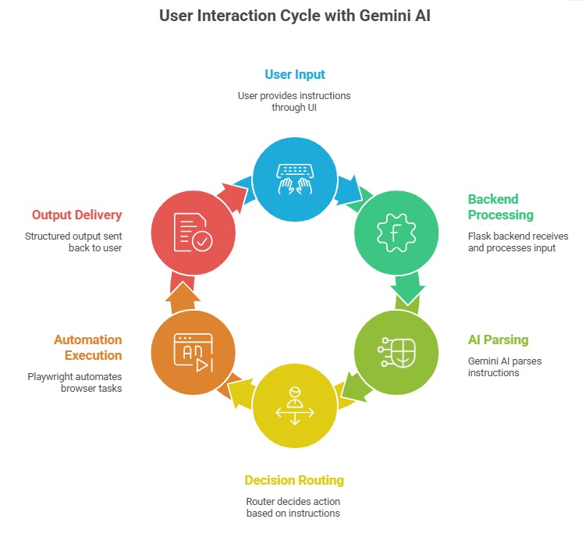
System Architecture Flow
Node js backend receives and process the response
GPT AI parses Instructions

Slide 6

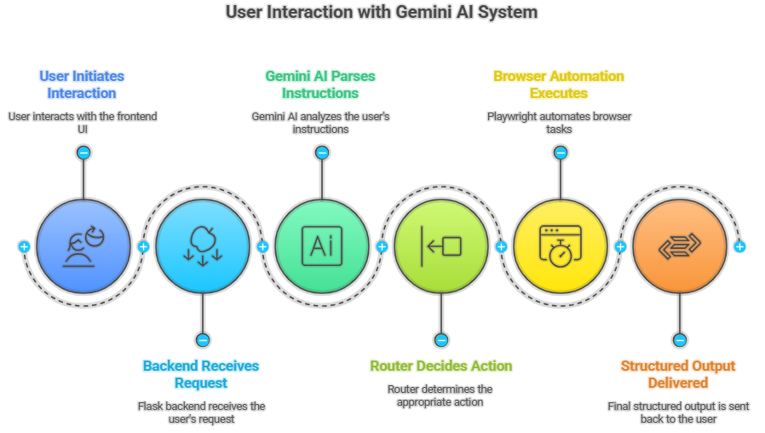




Technology Stack
Backend Layer
AI Processing
Browser Automation
Node.js Robust application framework managing system coordination and workflow execution
Ollama Local LLM integration for natural language understanding and intelligent task planning
Selenium Advanced web browser control for reliable, headless browsing automation

Slide 7

Key Advantages
⚡ Time Efficiency
🎯 Enhanced Accuracy
Automate hours of manual browsing into minutes of intelligent execution
Eliminate human error with consistent, precise web data extraction
🔒 Privacy Protection
🚀 Scalable Automation
Complete local execution ensures your sensitive data never leaves your machine
Handle complex, multi-site workflows that would be impossible manually

Slide 8
Real-World Applications
E-commerce Research
Job Market Analysis
Market Intelligence
Compare prices across multiple retailers, track product availability, and generate comprehensive shopping reports
Aggregate job postings from various platforms, analyze salary trends, and identify skill requirements
Collect competitor pricing, monitor industry trends, and generate automated market research reports

Slide 9

The Future of Web Automation and Conclusion
Web AI Navigator transforms the internet from a manual browsing experience into an intelligent, conversational interface where complex web tasks become as simple as asking a question.
Ready to Deploy
Scalable Solution
Local, secure, intelligent
From simple tasks to complex workflows
Future-Forward
AI-driven web automation

